Slide 1
Module 07
Insulation Coordination

Slide 2
Insulation Coordination
“The selection of insulation strength consistent with expected overvoltages to obtain an acceptable risk of failure.”
IEEE 1313
Scope of this module:
Overvoltages
Insulation strength
“risk of failure” is a specific area which is described in the literature but goes beyond the scope of this course

Slide 3
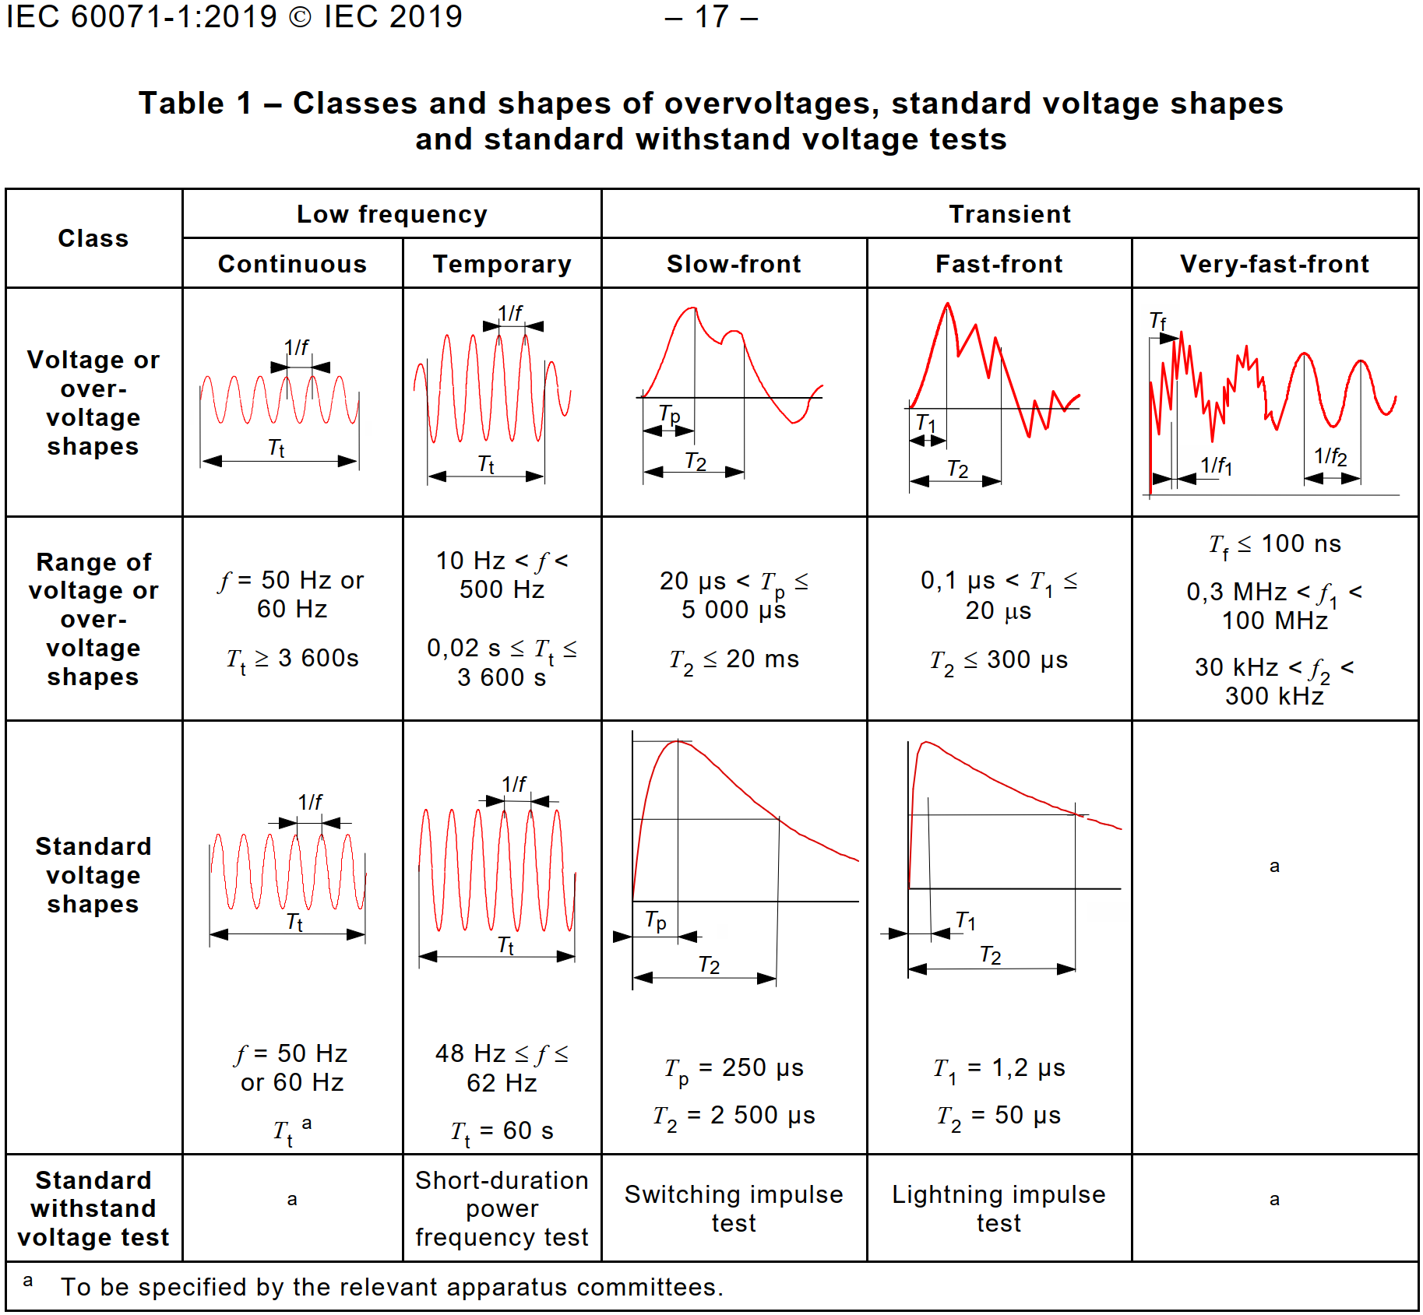
Overvoltages

Slide 4
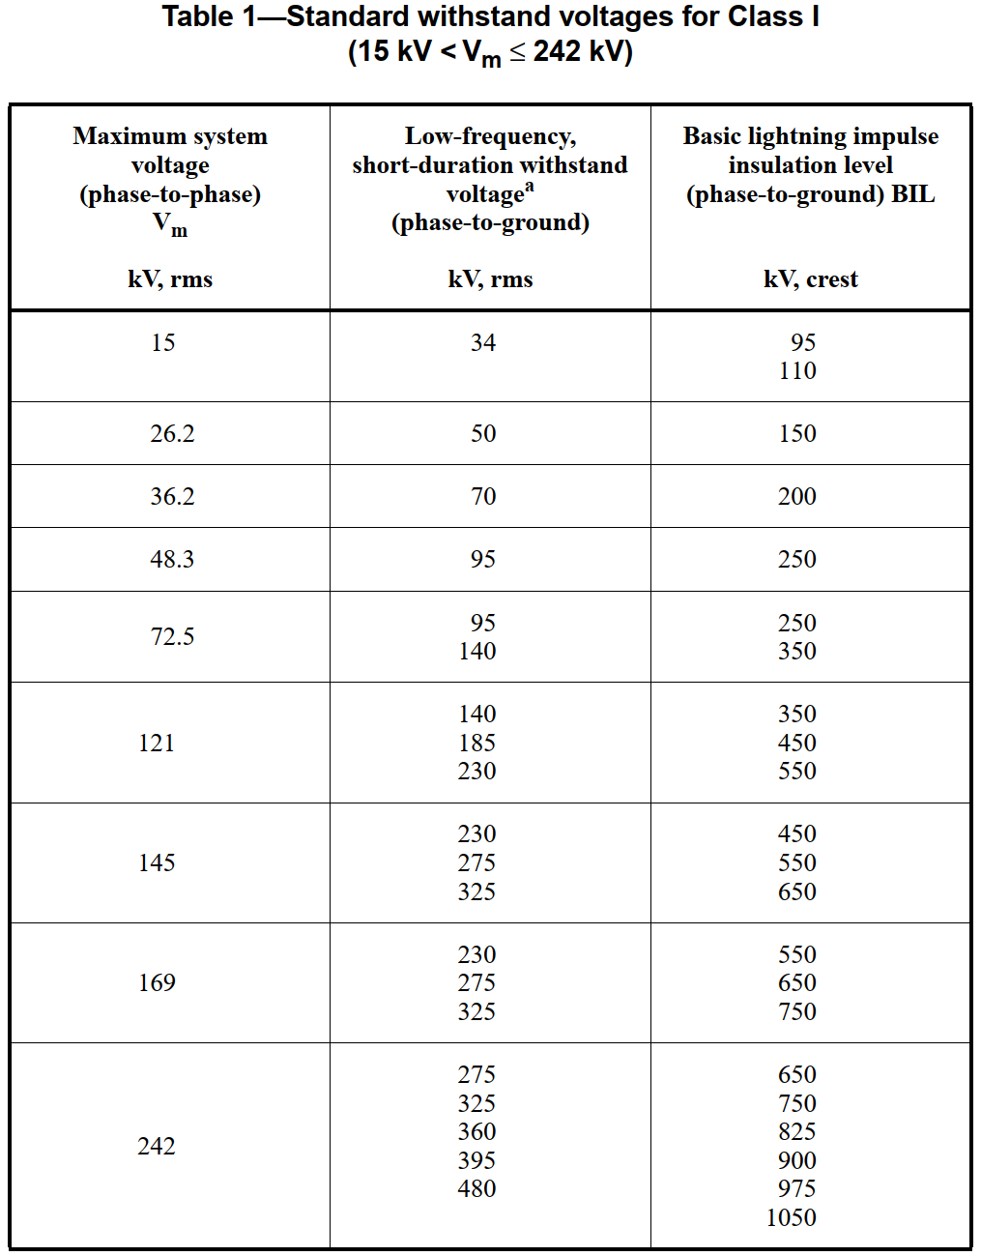
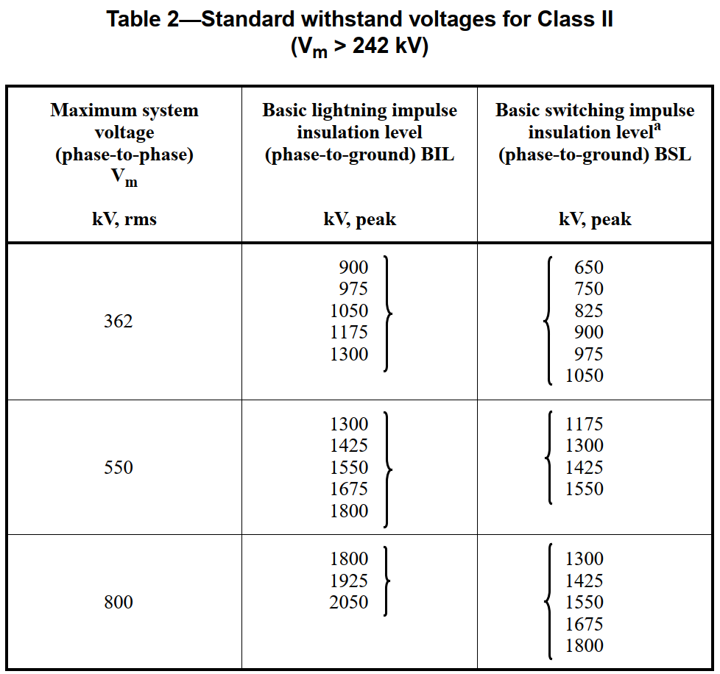
Transient overvoltage in the AC grid
IEEE Std 1313.1-1996

Slide 5
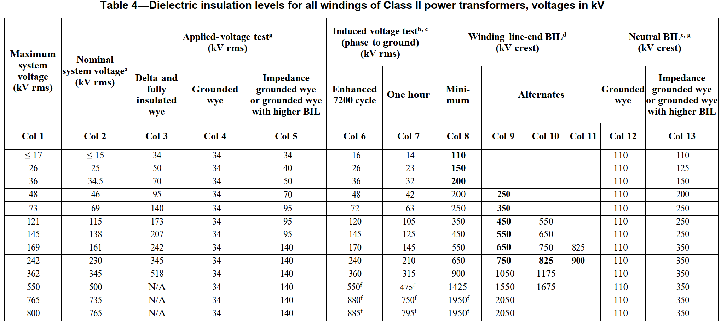
Transient overvoltage in the AC grid
Overvoltage in the AC grid grid reflect the “experience of the world” taking into account protective devices and methods of overvoltage limitation
For AC equipment other overvoltage levels can be specified: e.g. Transformers
IEEE Std C57.12.00™-2021

Slide 6
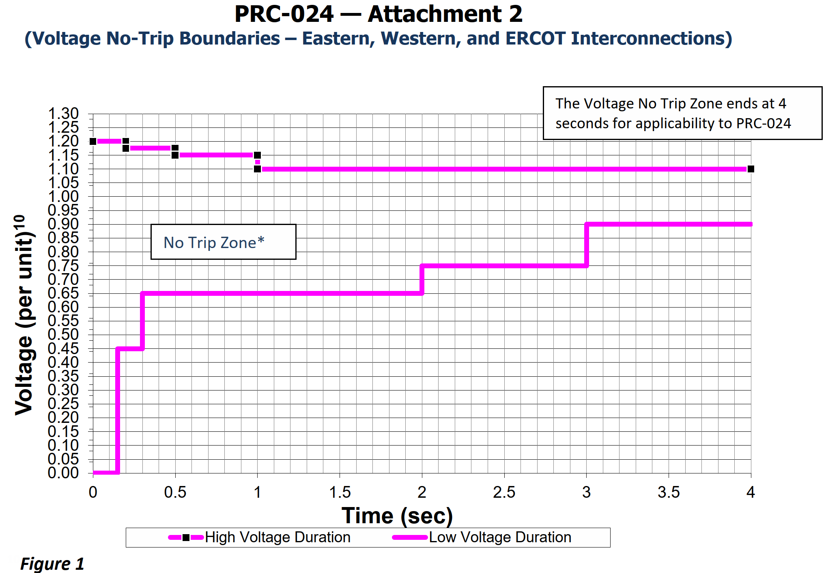
Temporary overvoltage in the AC grid
Temporary overvoltages are defined by grid codes such as IEEE 2800 or NERC PRC-024
Temporary overvoltages do not have an impact on the insulation coordination in the AC grid
PRC-024-3 —Frequency and Voltage Protection Settings for Generating Resources

Slide 7
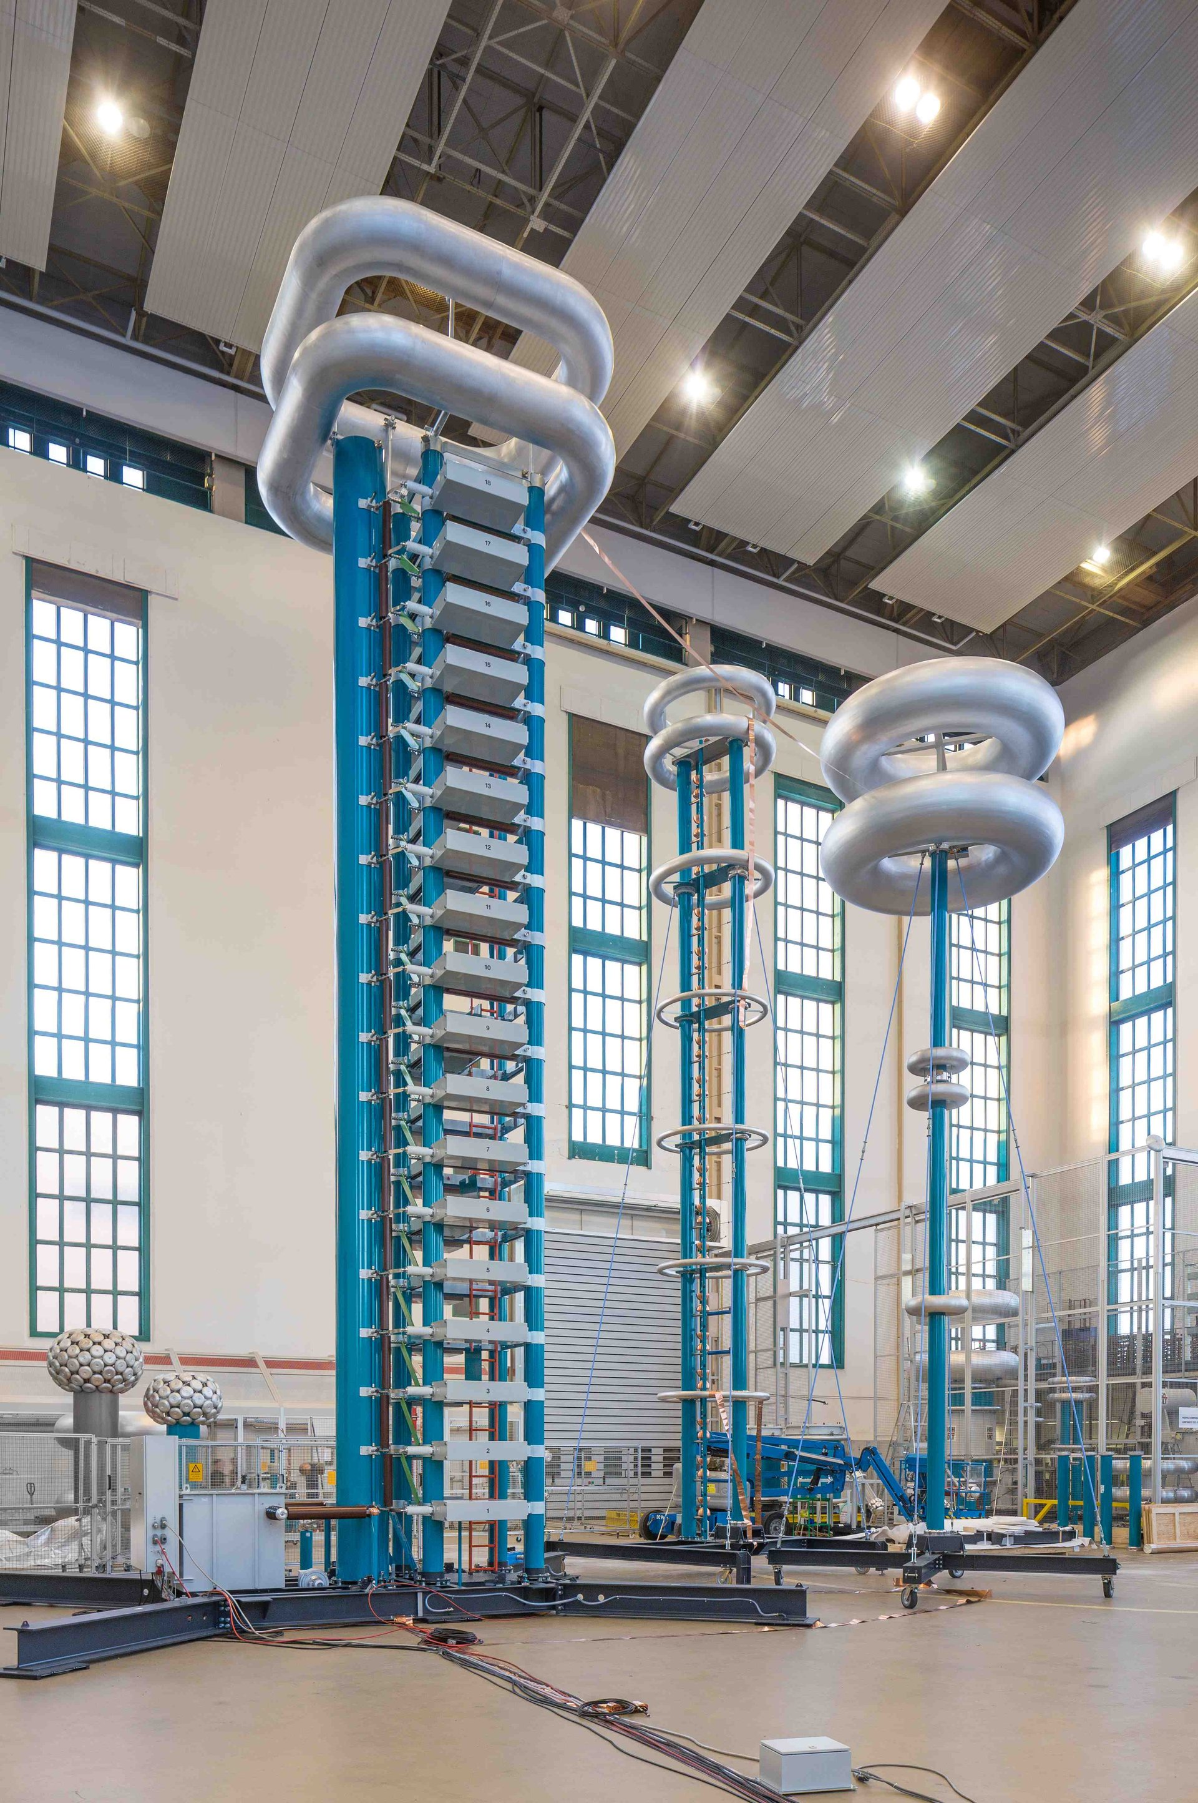
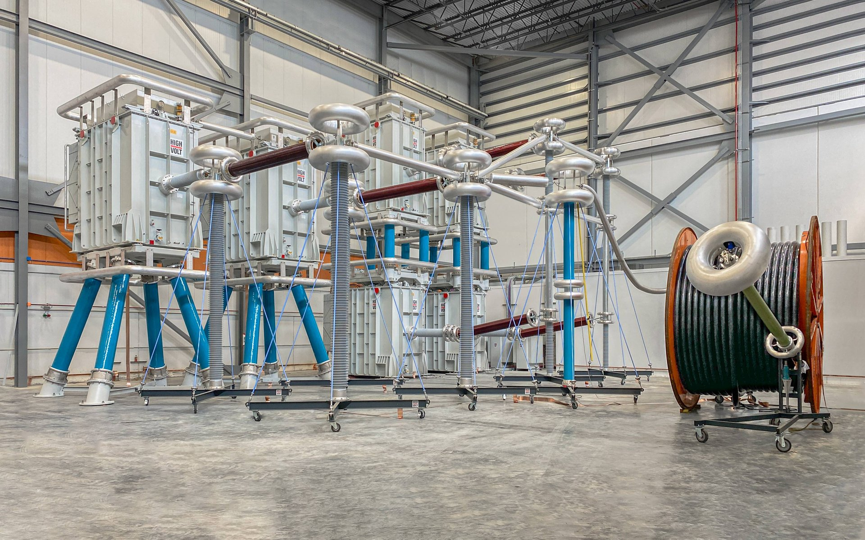
Insulation strength
Insulation strength can be verified by:
Testing in a high voltage lab
Definition of air clearances
www.highvolt.com

Slide 8
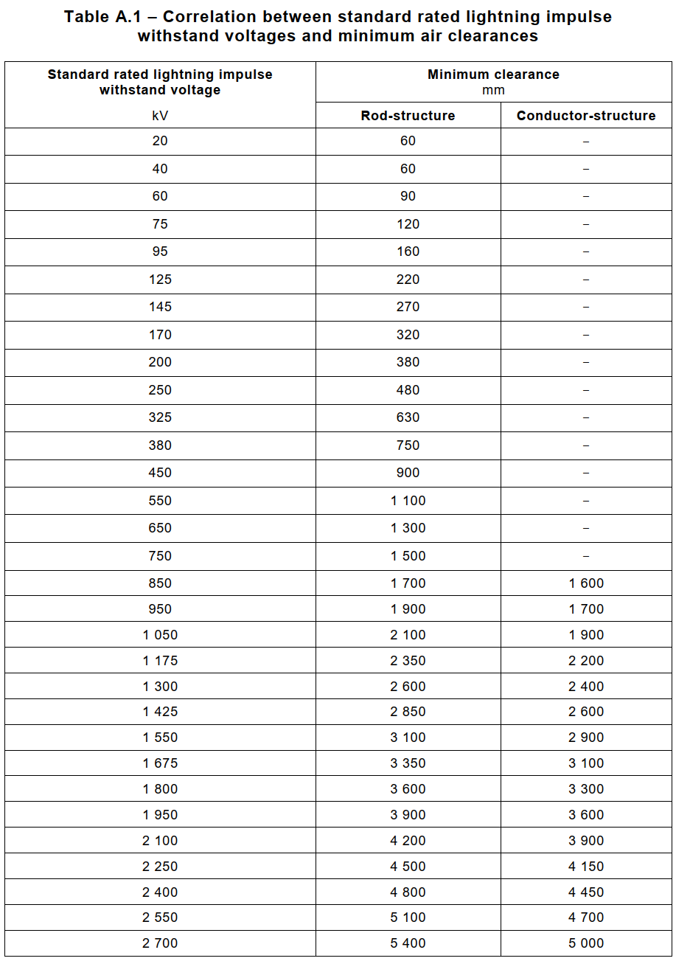
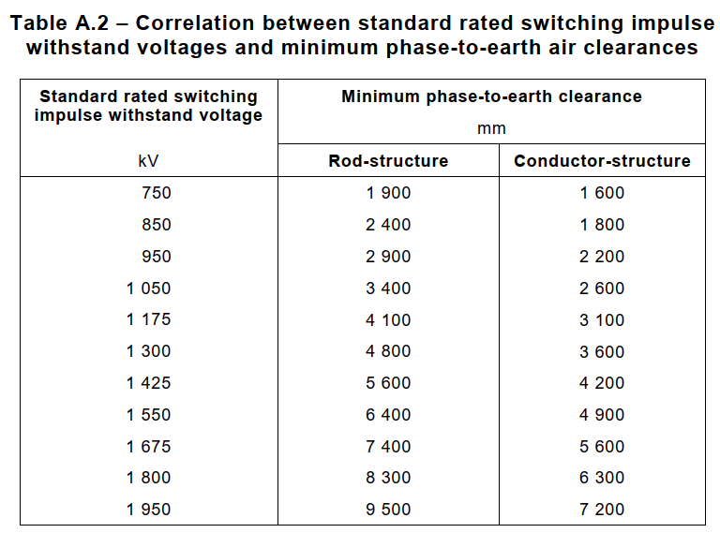
Air clearances
IEC 60071

Slide 9
Environmental conditions
Overvoltages apply for “Normal environmental conditions” and “Standard reference atmospheric conditions” as defined in IEC 60071-1 chapter “5.9 Environmental conditions”
Normal environmental conditions
Temperature range -40°C / +40°C
Altitude < 1000m
Ambient air is not significantly polluted
Standard reference atmospheric conditions for the specified overvoltages
Temperature: 20°C
Pressure: p₀ = 1 013 hPa (1 013 mbar)
Absolute humidity: h0 = 11 g/m3
In outdoor conditions “temperature” and “absolute humidty” compensate each other, so that the values can be applied and no correction is required
For indoor applications correction according to IEC 60060-1 is required

Slide 10
Overvoltage definition
Overvoltages inside the converter are not based on the experience values
Definition of the overvoltages must be based on EMT type simulations
Modelling of the components must be adjusted to the anticipated analysis
Simulation time step must be appropriate to the simulation
Transformer representation considering capacitive effects inside the transformer

Slide 11
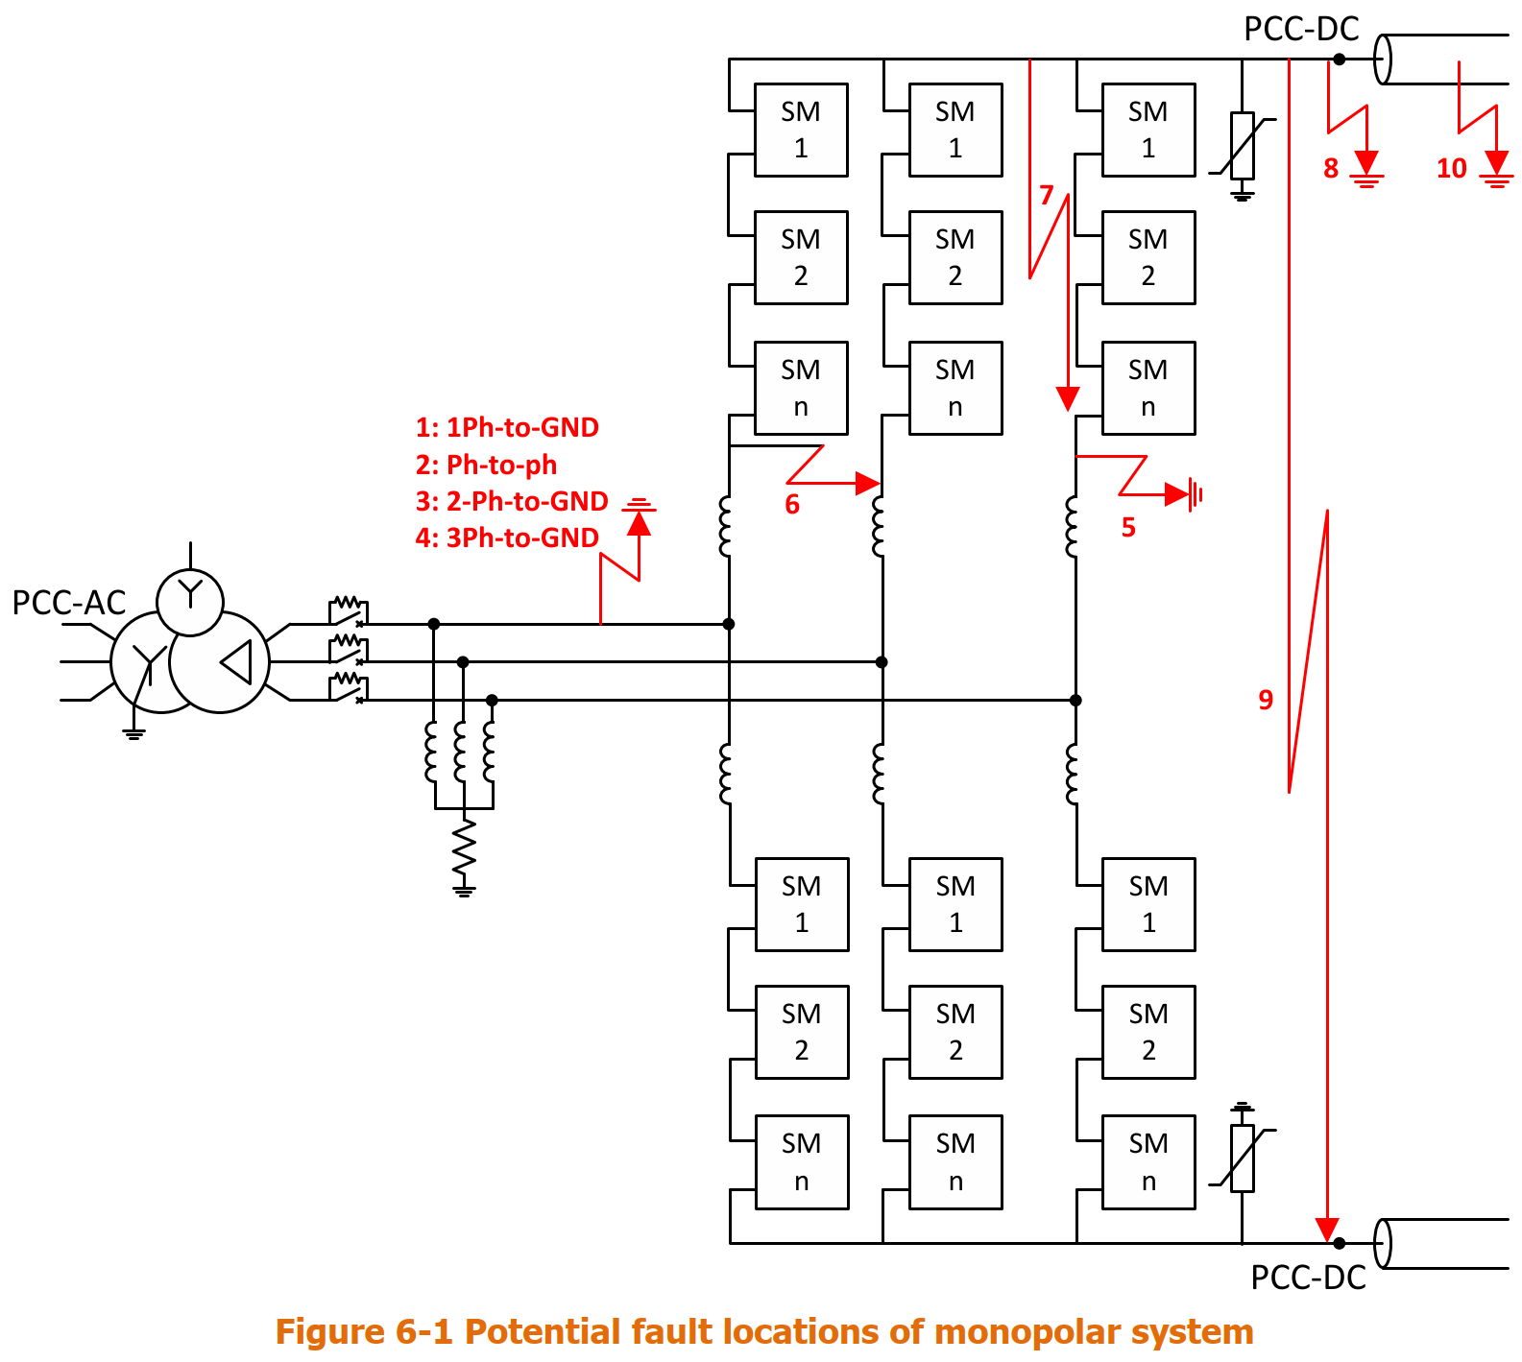
Faults for overvoltage definition
Overvoltages within the converter are defined by converter internal faults
Converter internal faults are given by converter design
Fault clearance depends on:
DC protection (DC fault detection)
Circuit breaker operation
CIGRE_832_Guide for Electromagnetic Transient Studies Involving VSC Converter

